Slide 1
Husky Adapt REU
Joe Lawler

Slide 2
What is Husky Adapt?
A program at the University of Washington where teams of students take on design challenges each year
Works to foster an inclusive, sustainable and multidisciplinary community supporting accessible design

Slide 3
What is Sustainable Design?
A design process focused on preservation and continuation
Ensures work is organized enough to be iterated upon and improved

Slide 4
Design Projects 2017-2018
Guiding Questions
How do we ensure sustainability of projects between years?
How do we share results with the broader community?
Need
A website that ensures the sustainability of the club and showcases past accomplishments

Slide 5
Design Projects 2017-2018
Process
Performed Case Studies on other research pages
Selected information to be posted; in line with guiding questions
Organized with user interaction in mind

Slide 6
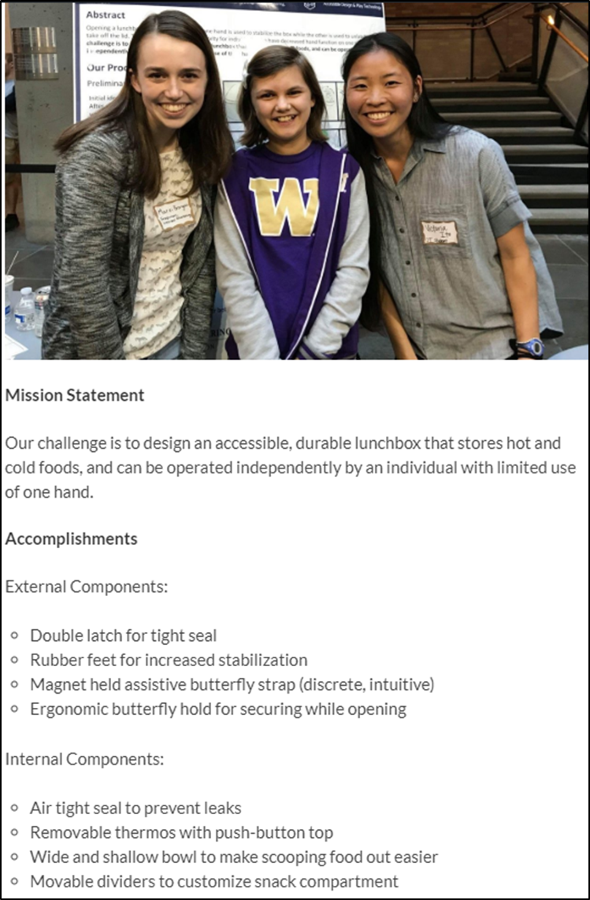
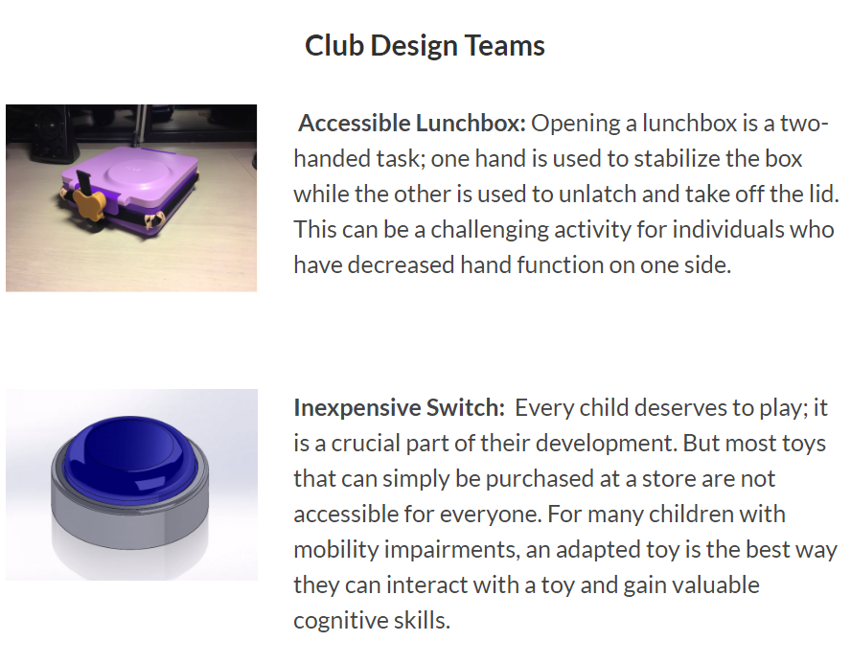

Slide 7
Design Challenges 2018-2019
Guiding Questions
How do we reach out to need experts for design project ideas and partnerships?
How do we pick design projects for impact?
Need
System for reaching out to need experts and setting up design challenges for next year

Slide 8
Design Challenges 2018-2019
Design project survey is inclusive and sets expectations for need experts and teams; incorporated feedback from experts in the field
Interview document for meetings with need experts to ensure the correct information is gathered
One page summary of each design challenge for incoming student teams providing more direction and detail

Slide 9
Furthering a Design Project
Erin Ciliv

